Slide 1
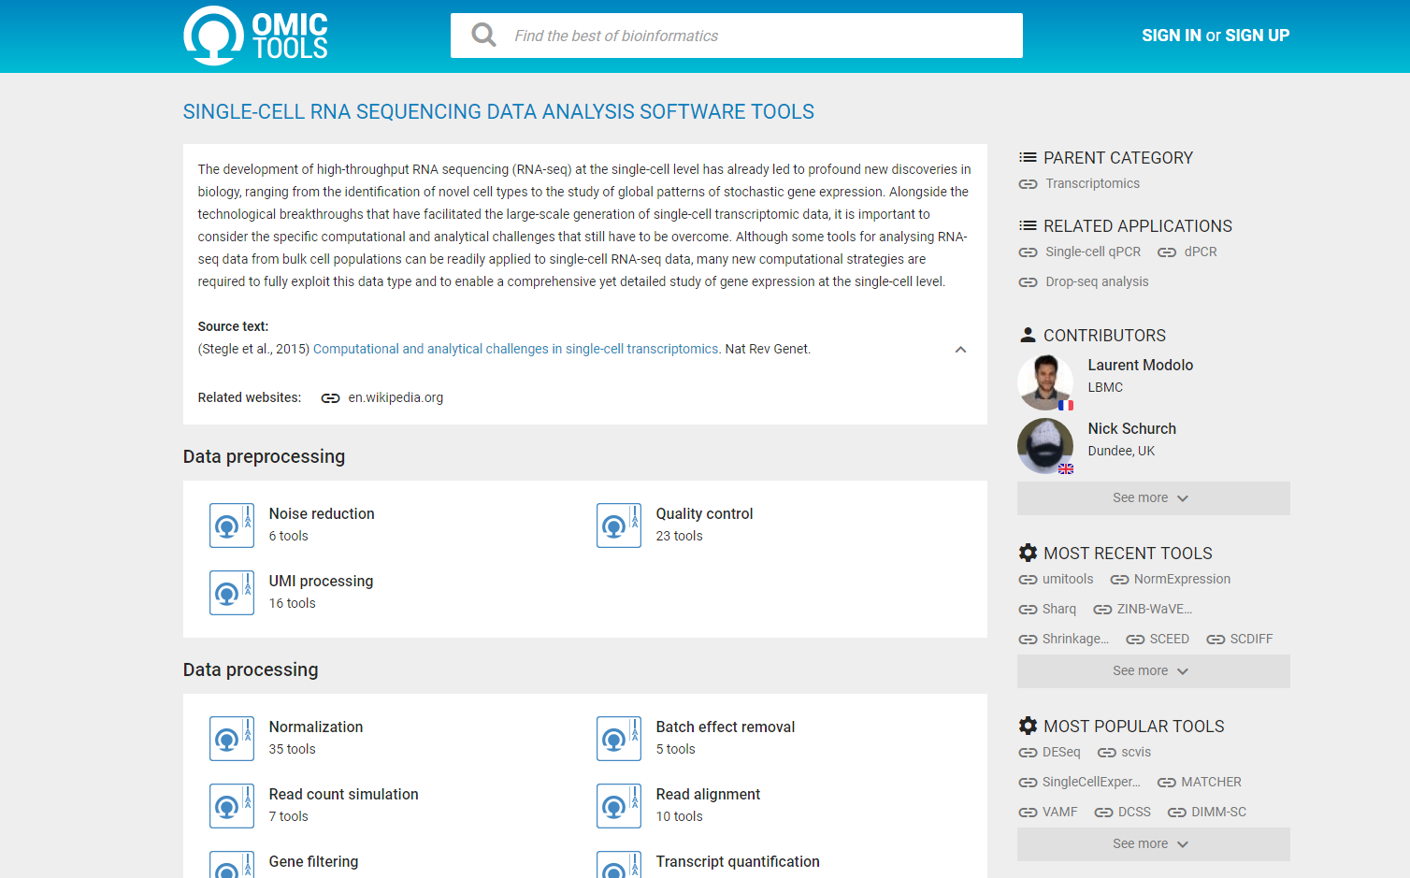
(1) OMIC TOOLS: SINGLE-CELL RNA SEQUENCING DATA ANALYSIS SOFTWARE TOOLS
https://omictools.com/single-cell-rna-seq-category

Slide 2
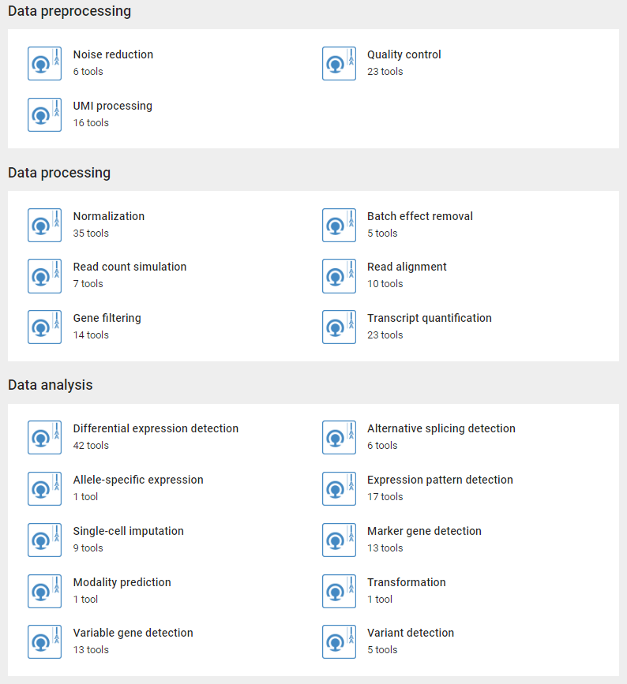
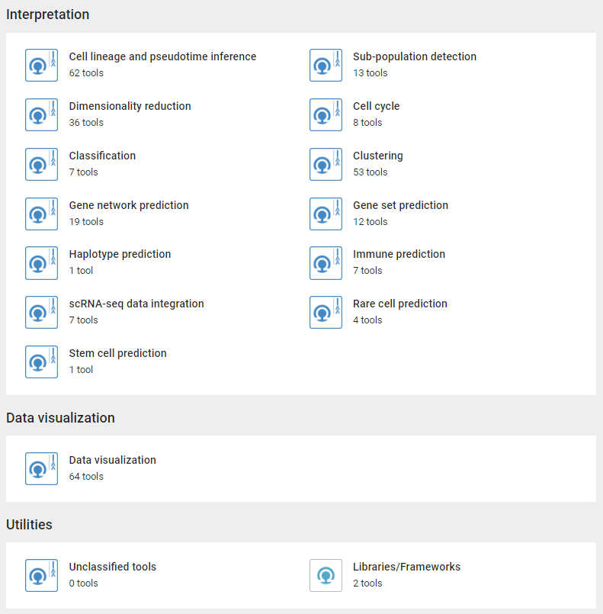

Slide 3
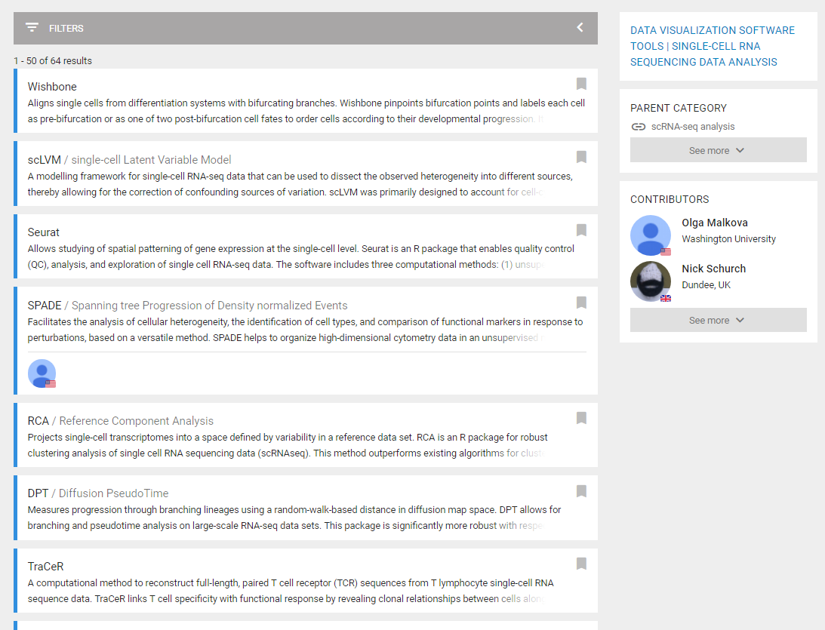

Slide 4
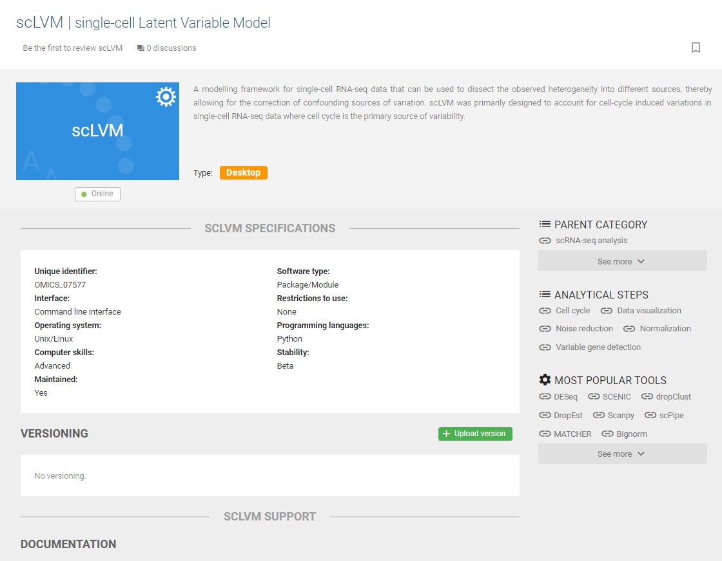

Slide 5
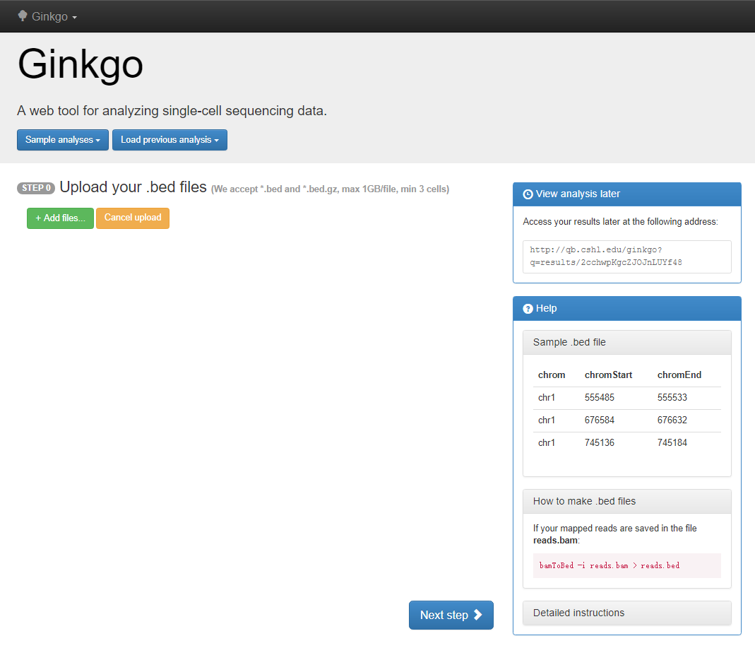
(2) Ginkgo: A web tool for analyzing single-cell sequencing data
http://qb.cshl.edu/ginkgo/?q=/2cchwpKgcZJOJnLUYf48

Slide 6
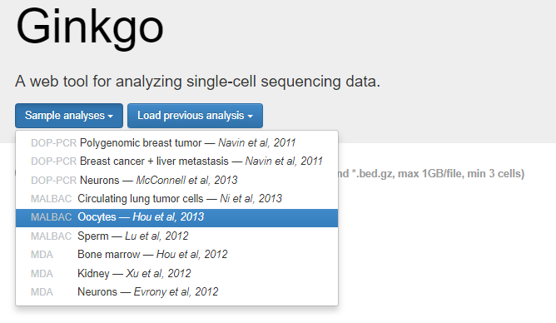
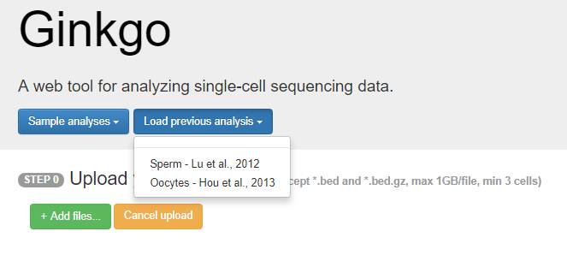

Slide 7
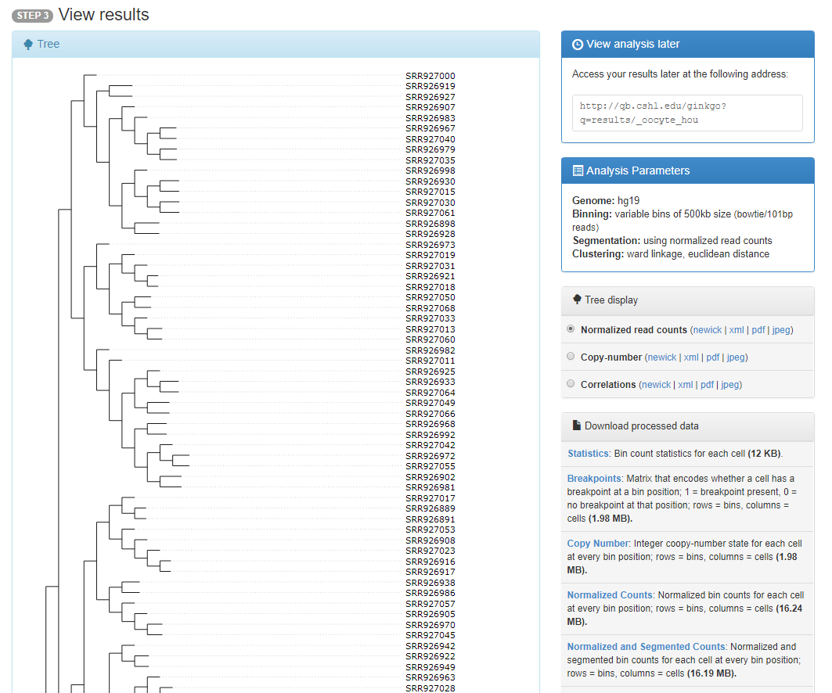

Slide 8
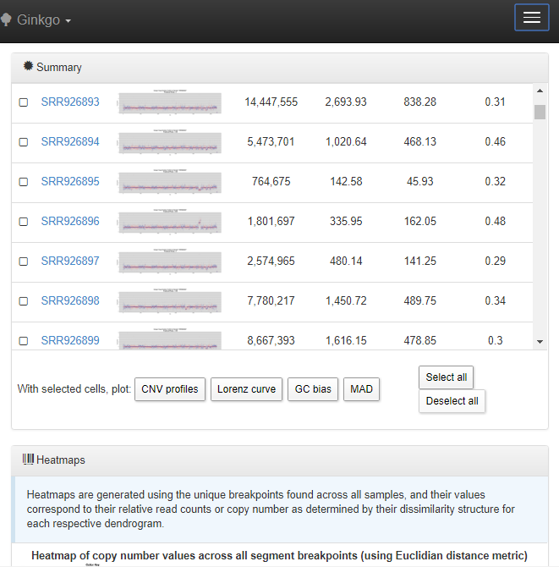

Slide 9
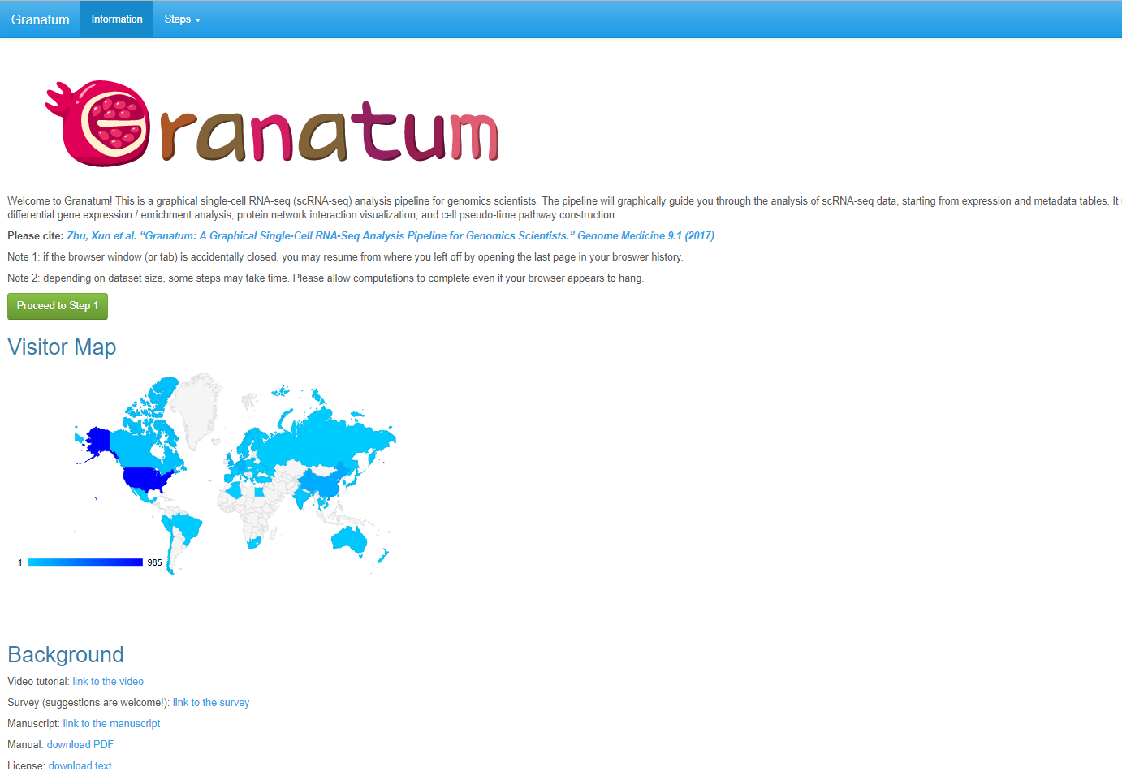
(3) Granatum: a graphical single-cell RNA-seq analysis pipeline for genomics scientists
http://ilab.hawaii.edu:8102/?_state_id_=04f1d60e58f163c4&tab=info

Slide 10
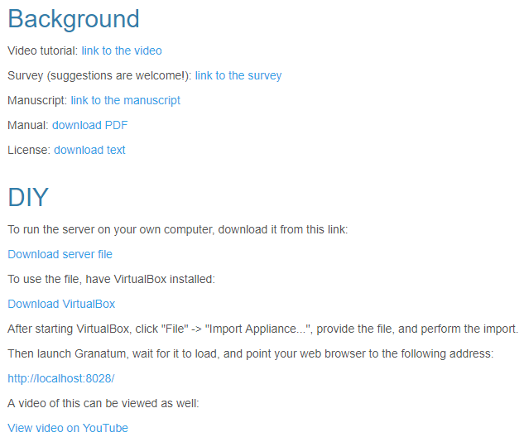

Slide 11
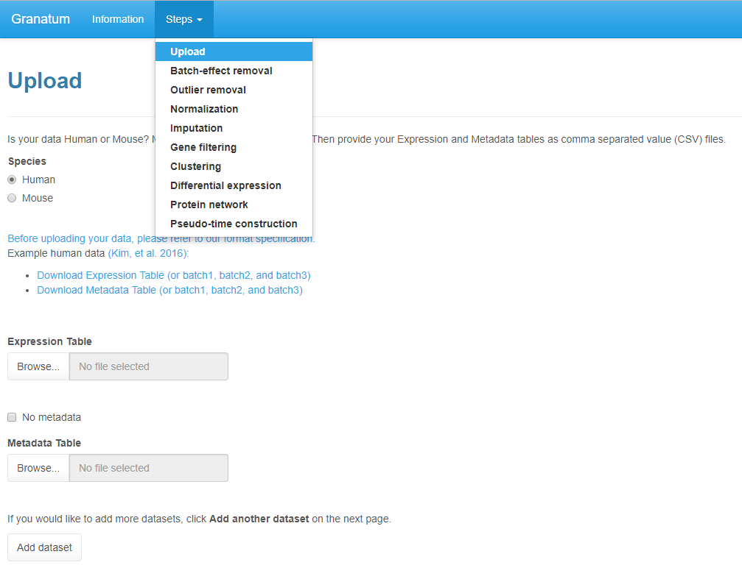

Slide 12
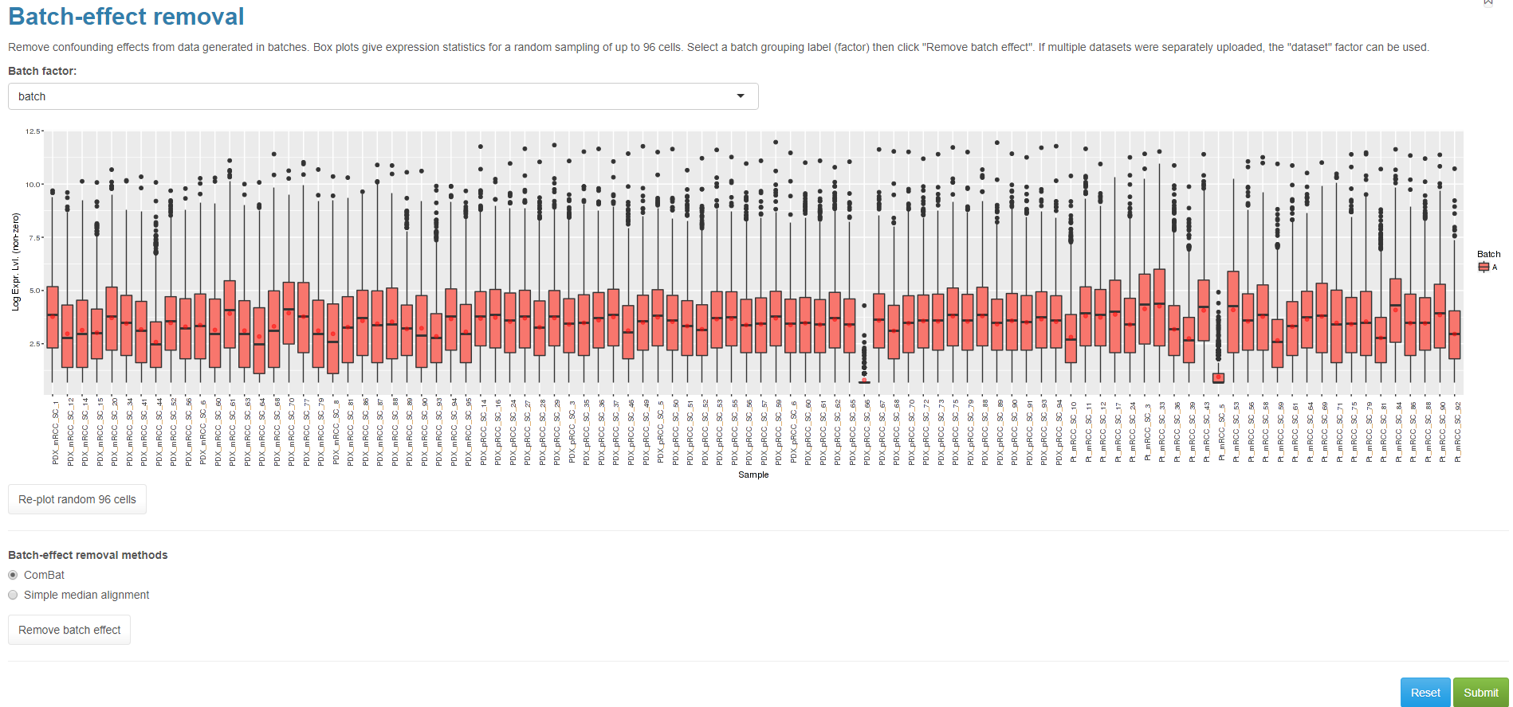

Slide 13
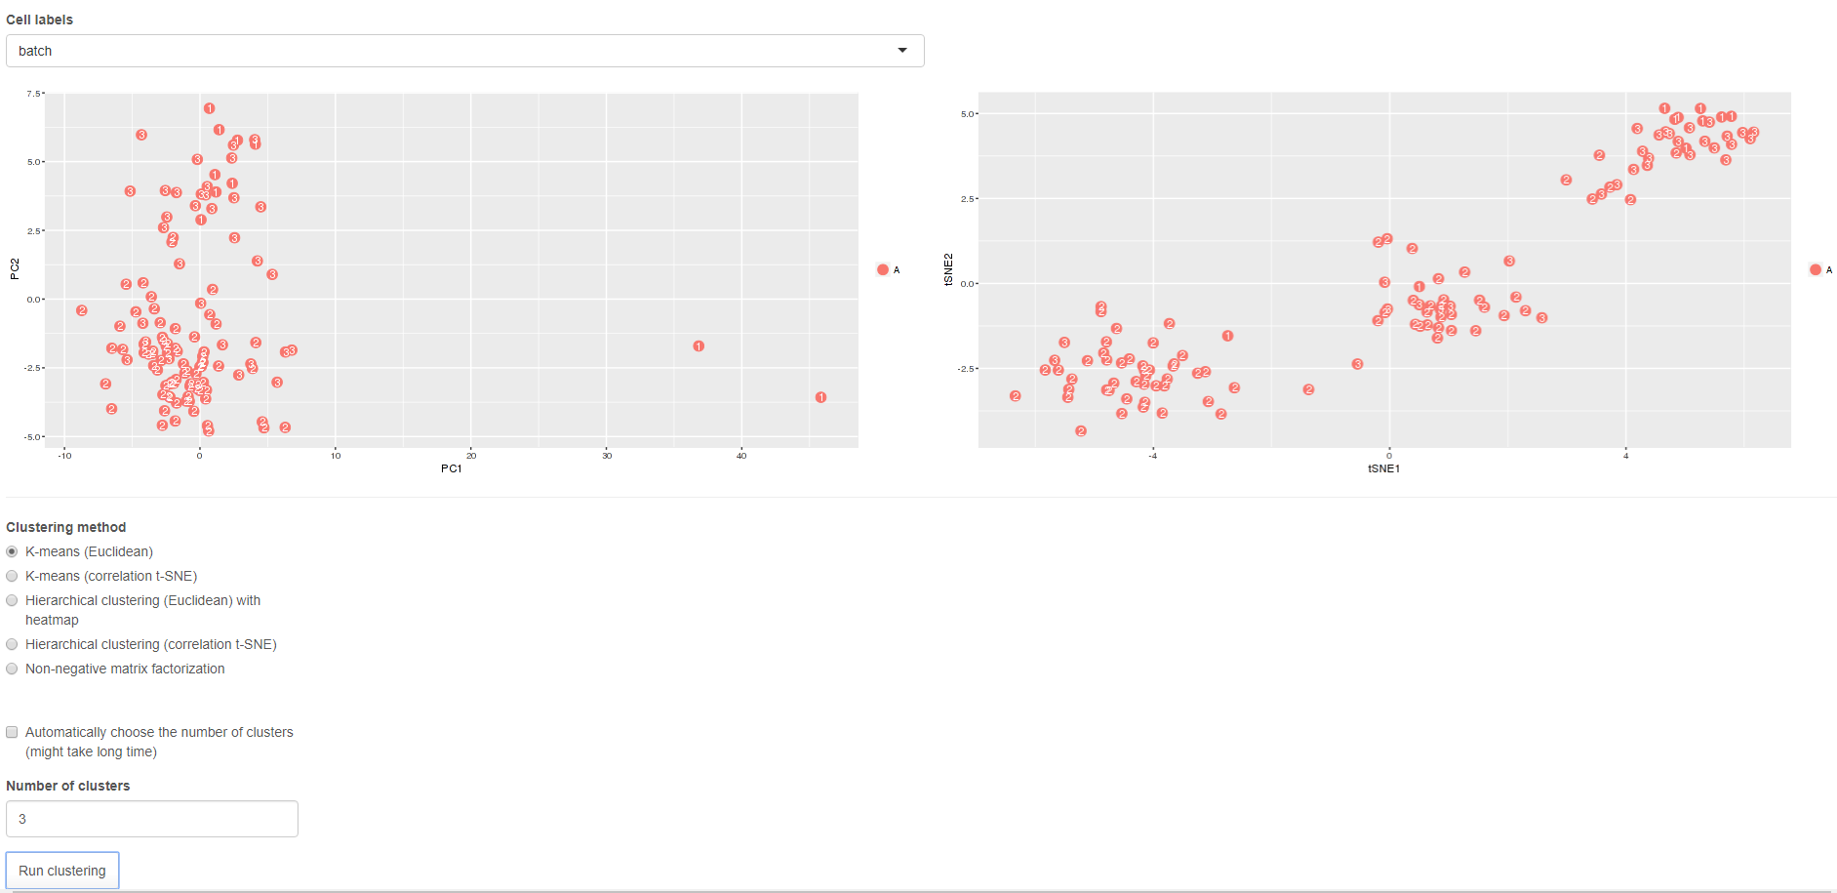

Slide 14
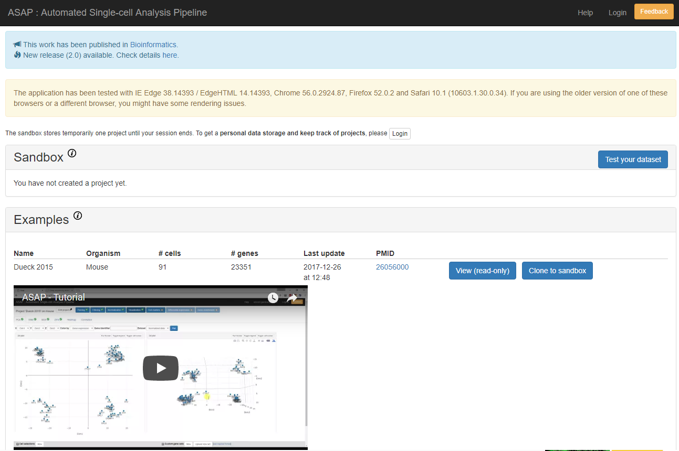
(4) ASAP: Automated Single-cell Analysis Pipeline
https://asap.epfl.ch/

Slide 15
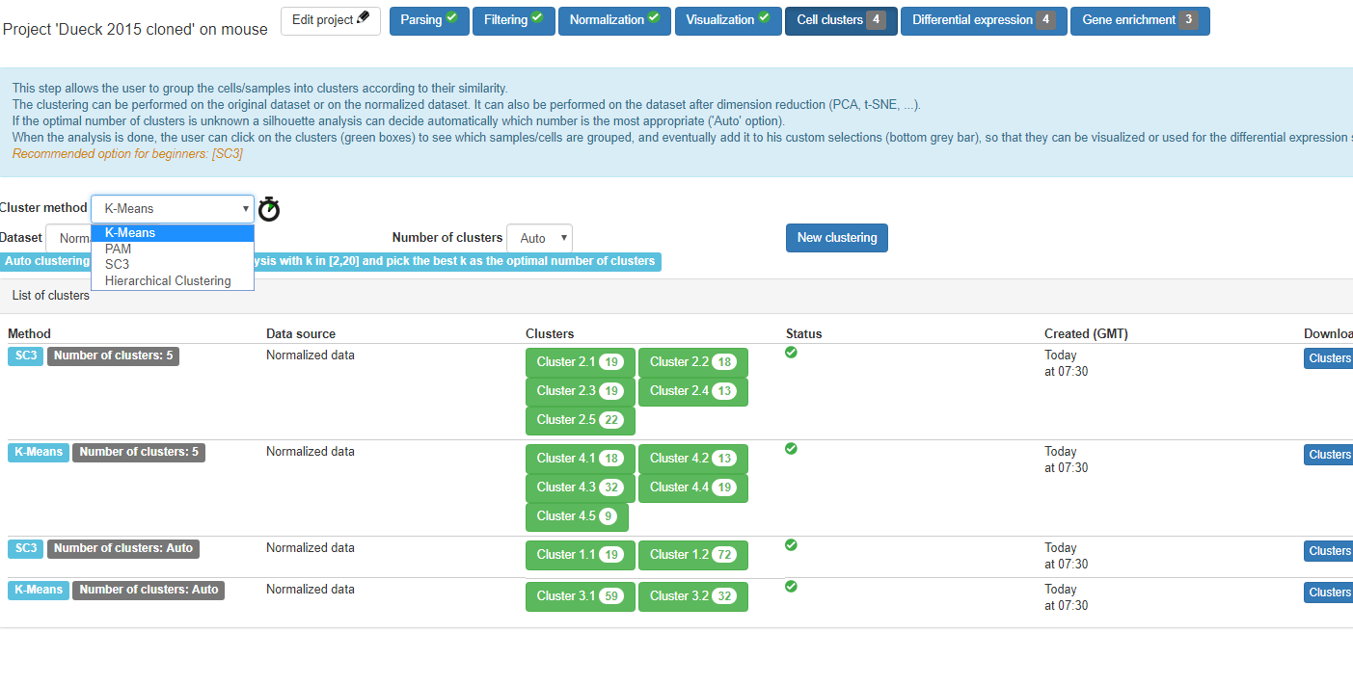

Slide 16
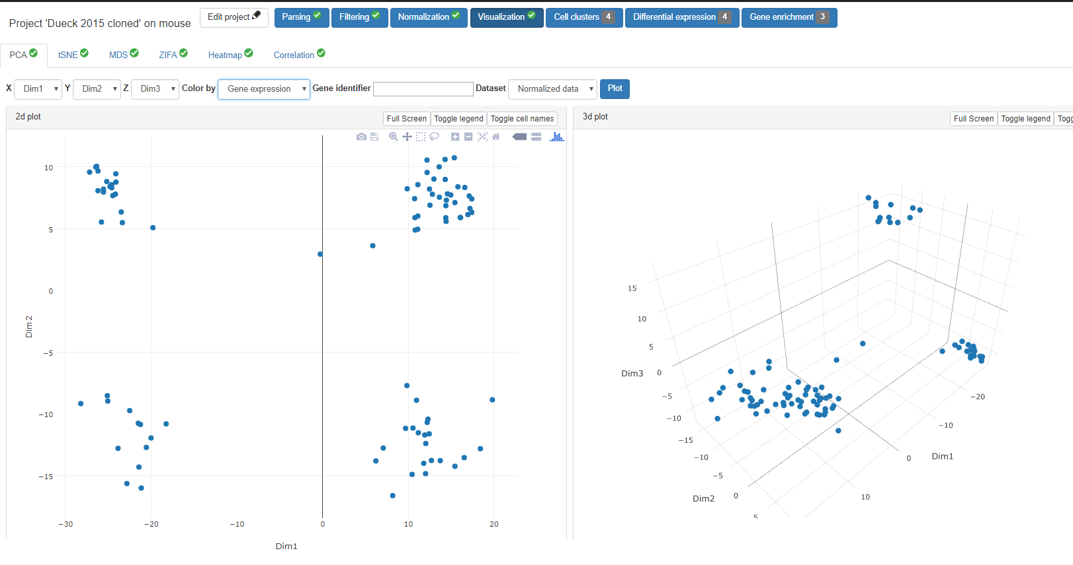

Slide 17
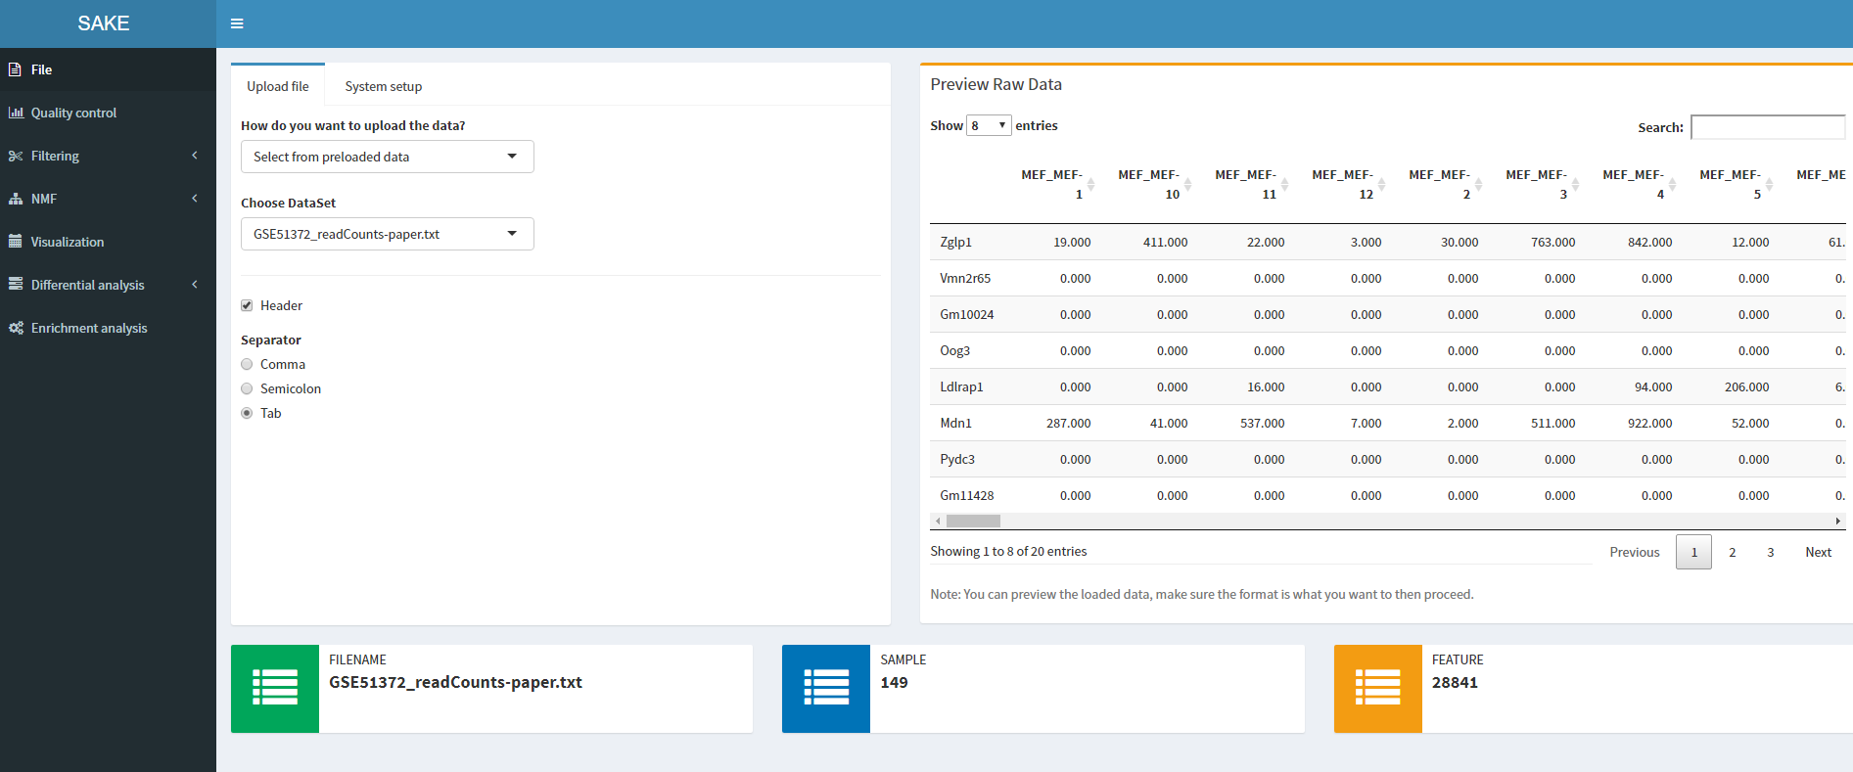
(5) SAKE: Single-cell RNA-Seq Analysis and Clustering Evaluation
http://sake.mhammell.tools/

Slide 18
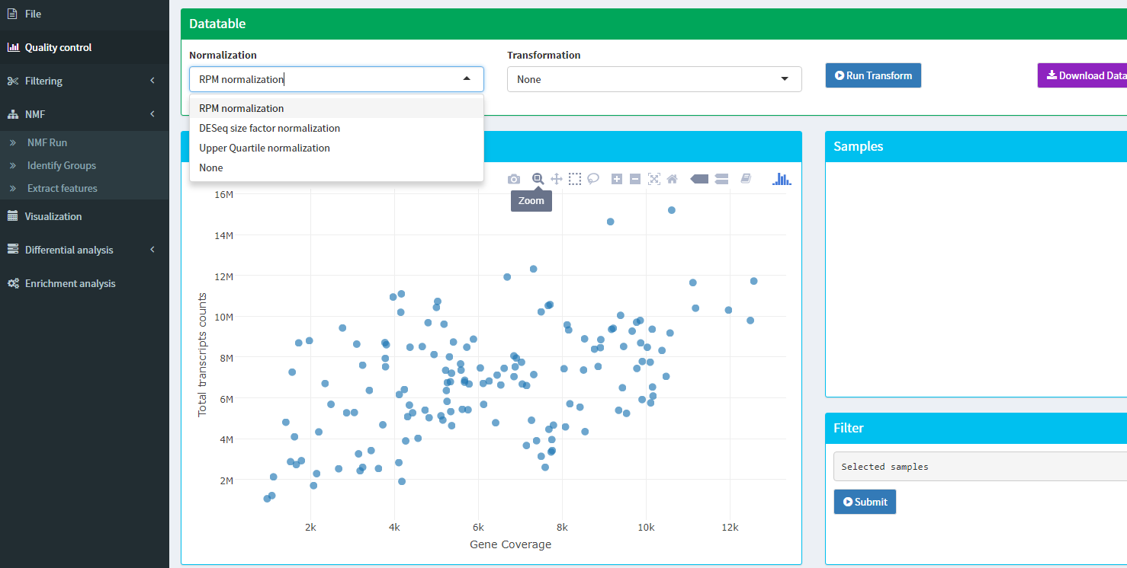

Slide 19
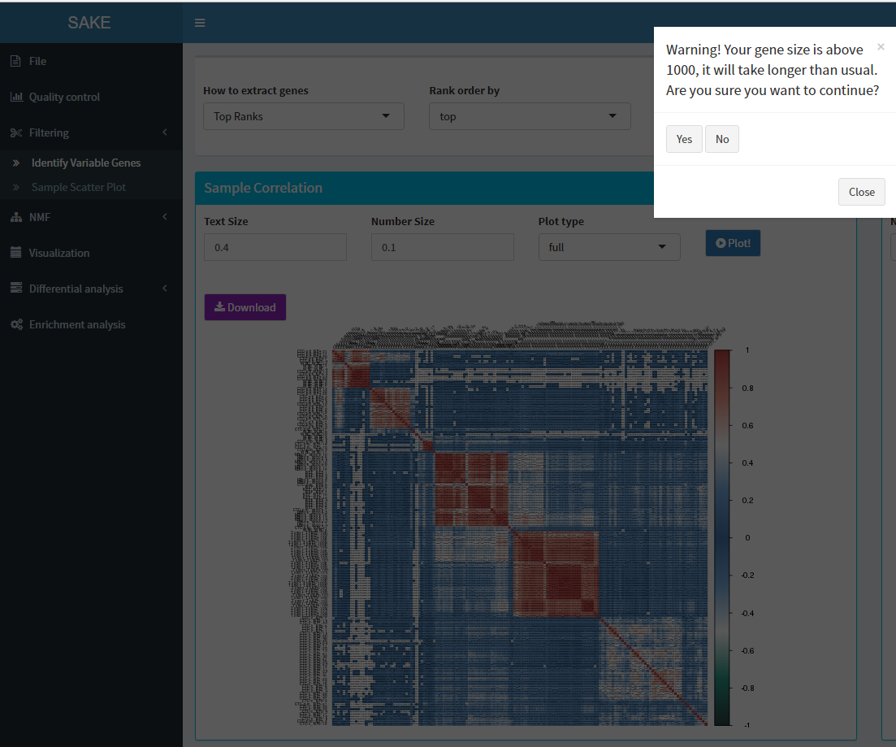

Slide 20
